Slide 1
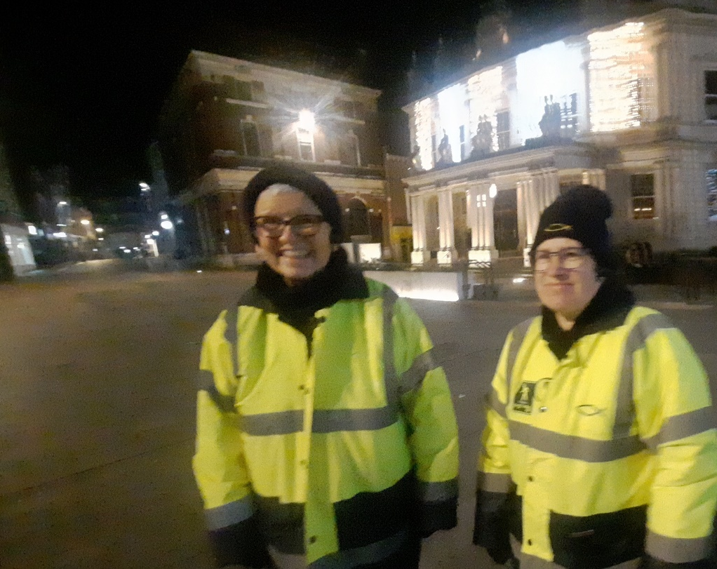
Ipswich Town Pastors
Newsletter 5

Slide 2

Ipswich Town Pastors
Welcome to our Newsletter
We are in no doubt that there is a need for Town Pastors on the streets of Ipswich. Since Ipswich Town pastors formed in the wild weekends of a generation ago things have quietened down somewhat, but not completely. We still encounter people in need of care and, in some cases, protection by our simply being there.

Slide 3
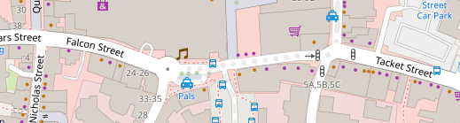
Ipswich Town Pastors
Over the years the number of late-night venues has decreased and the streets have become quieter. Most of our late-night venues are located between Dog’s Head Street and Tacket Street, so revellers are not wandering about as much as before, but we still come across people who need help or want to talk.

Slide 4
Ipswich Town Pastors
The not-so-quiet Revival
It is fascinating to be out in Town late on a Saturday night—we meet all ages, but mainly under-30s.
We have had deep conversations about faith with people who are genuinely interested, asking us about our beliefs. We are seeing a slowly growing awakening going on.
Praise God!

Slide 5
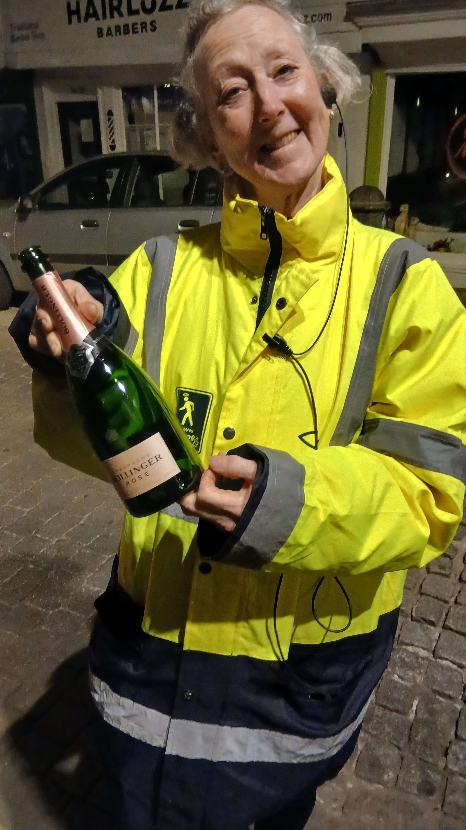
Ipswich Town Pastors
The Gentrification of Ipswich?
We pick up and bin glass bottles as they can be used as weapons. We also pour away any liquid content.
Finding this bottle of Bolly was a first for us.
It was empty.

Slide 6
Ipswich Town Pastors
Questions
We were stopped by a young man in a group of four and asked if we were “the Christians”. We said yes, and we had a deep conversation about the nature of God, especially with regard to homosexuality, a sticking point for him—does God condemn homosexuals?
Two others were engaged in an argument about faith and scientific proof (are they independent of each other?).

Slide 7
Ipswich Town Pastors
The first man then realised we’d met before on a Saturday night a few months back. I told him I’d been praying about him from time to time over the intervening period.
Would you pray for him and all the other Gen Z people, too?

Slide 8
Ipswich Town Pastors
Thanked by the police!
We came across a young woman slouched in a shop doorway on St Nicholas Street. Her boyfriend was standing nearby telling anyone passing that he paid his taxes and why wasn’t the ambulance he called right here now?!
We knelt down to chat with her. She was drunk but not in need of an ambulance. She needed TLC and time to recover.

Slide 9
Ipswich Town Pastors
Was there anything she wanted? She said she just wanted her boyfriend to sit down with her.
By now he’d managed to engage three police officers in an argument, and was placing himself in danger of being arrested.
People who’ve drunk too much often say things over and over, and this chap was definitely stuck on repeat.

Slide 10
Ipswich Town Pastors
One of us tried to distract the young man from harassing the police officers. We had a bit of conversation and a handshake. He’d calmed down a bit.
The ambulance arrived and he started up again. The paramedics took one look at him and said there was no way he’d be coming into the ambulance with his girlfriend.

Slide 11
Ipswich Town Pastors
They took her in, shut the doors and stayed in the van with her until she’d sobered up.
Afterwards one of the police officers came over to thank us for helping calm the situation down. The last thing they want is to be forced into arresting gobby people.

Slide 12
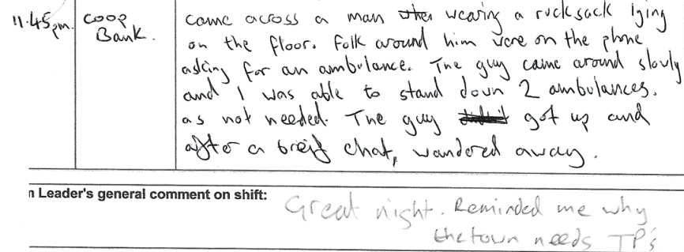
Ipswich Town Pastors

Slide 13
